Slide 1
GORGEOUS SNAPS (Photo Sharing Community)
By : Sultan S. Kazi
Seat Number : 3028187

Slide 2
Index
Introduction
Purpose
Hardware Requirements
Software Requirements
Used Technologies
Features
Limitations
Screenshot
Future Scope
Conclusion

Slide 3
Introduction
Gorgeous Snaps - Unique social networking platform.
Completely based on sharing photos.
Developed by keeping in mind the needs of the professional photographers and individual users.
Developed as per the basic requirements of any individual user.
In short, Gorgeous Snaps is all about capturing and sharing the world’s moments.

Slide 4
Purpose
The main purpose of this project is to let the professional photographers, from various parts of the world, show off their excellent photography skills to the whole wide world!
Individual users can share their beautiful, gorgeous, and special moments with their friends and family.
Basically, a user can :
share photos
like or unlike photos
comment on photos
follow or unfollow other users
message other users in real time
explore other user’s photos, etc.

Slide 5
Hardware Requirements
Memory: 1GB RAM
Disk space: Capacity of minimum 1.5GB Hard Disk space.

Slide 6
Software Requirements
Compatible OS: Windows XP SP3+, Windows Vista SP2+, Windows Server 2003 SP2+, Windows 7, Windows Server 2008, Windows Server 2008 R2.
PHP version 7.2.14
WAMP Server version 3.1.7

Slide 7
Used Technologies
A] Front-End :
HTML (HyperText Markup Language)
CSS (Cascading Style Sheets)
JavaScript
Bootstrap (CSS Framework)
AJAX (Asynchronous JavaScript And XML)
B] Back-End :
PHP (Hypertext Preprocessor)
MySQL (Database)

Slide 8
Features
Secure.
Friendly User Interface.
Easy To Use.
Photo Sharing with the World!
Verification and Validations.
Use of AJAX!
Liking a photo.
Unliking a photo.
Commenting on a photo.
The user can delete the comments he/she made on a photo.

Slide 9
Features
Ability to let the user delete all of the comments on the photo that he/she shared.
Users can follow/unfollow other users.
Real time messaging with other users.
Real time notifications.
Reporting a photo to the admin.
Reporting a user to the admin.
Admin Dashboard with visualized data, etc.

Slide 10
Limitations
User can only share the photos with .jpeg, .jpg, .png, and .bmp image file format.
User cannot mention other users in the comments or in the caption of his photo.
Users won’t get any notification for the replies on their comments as there is no specific option implemented to reply to a comment.
User cannot see the users he has messaged before.

Slide 11
Limitations
User can read the caption of the photo and see who has liked the photo only on the feeds and details page.
User can only read the 3 recent comments made on a photo on the feeds page.

Slide 12
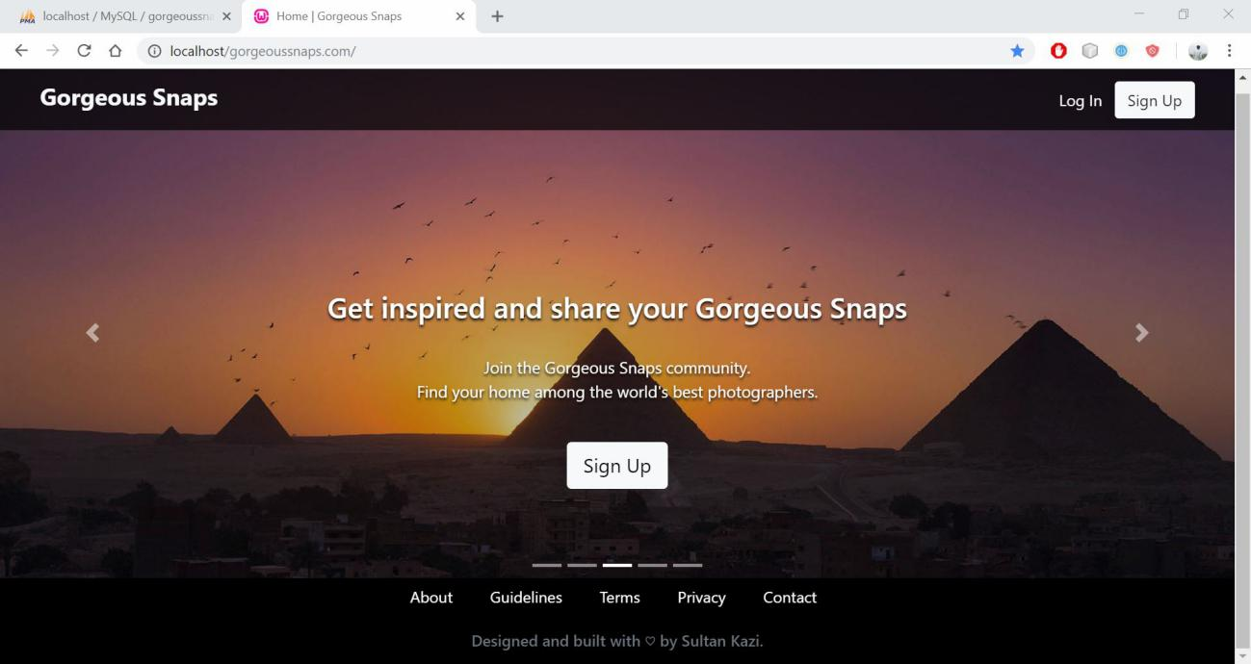
Screenshot
Index (Home) page :

Slide 13
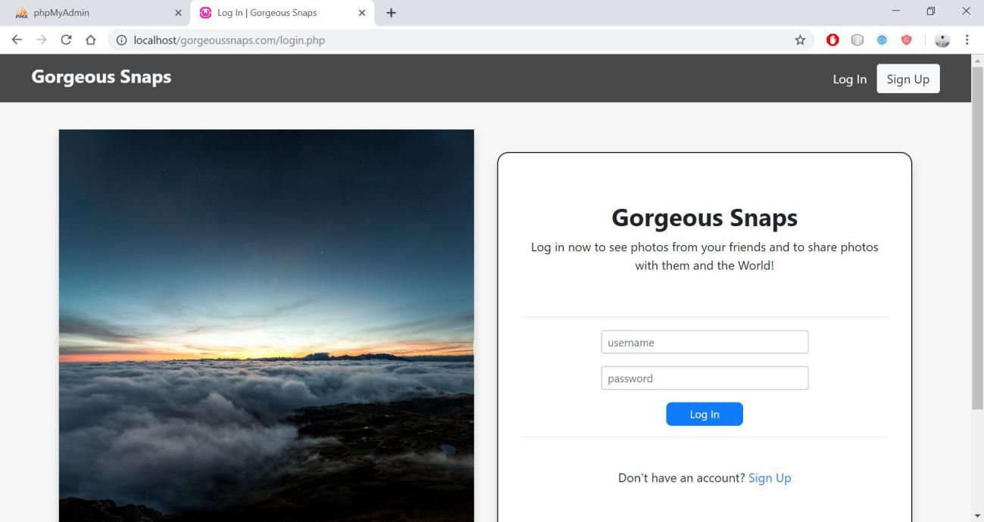
Screenshot
Log In Page :

Slide 14
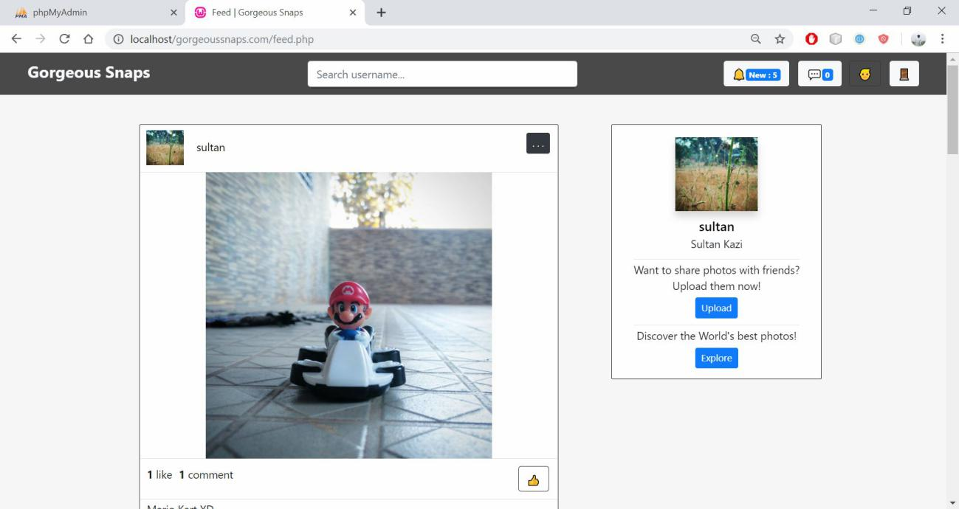
Screenshot
Feed Page :

Slide 15
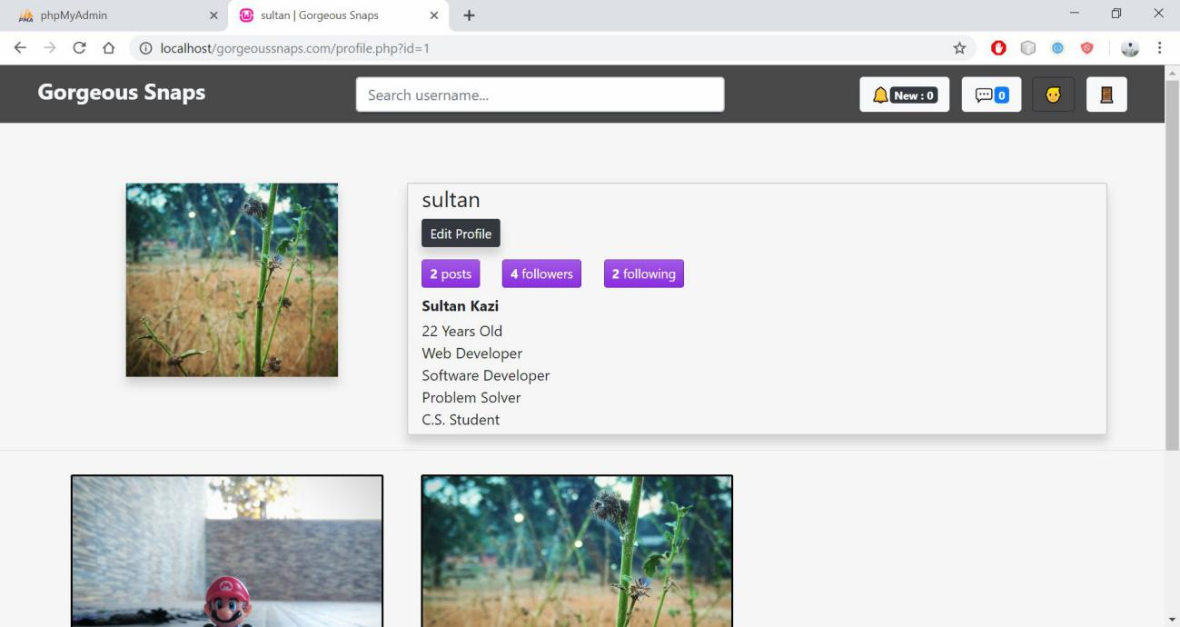
Screenshot
Profile Page :

Slide 16
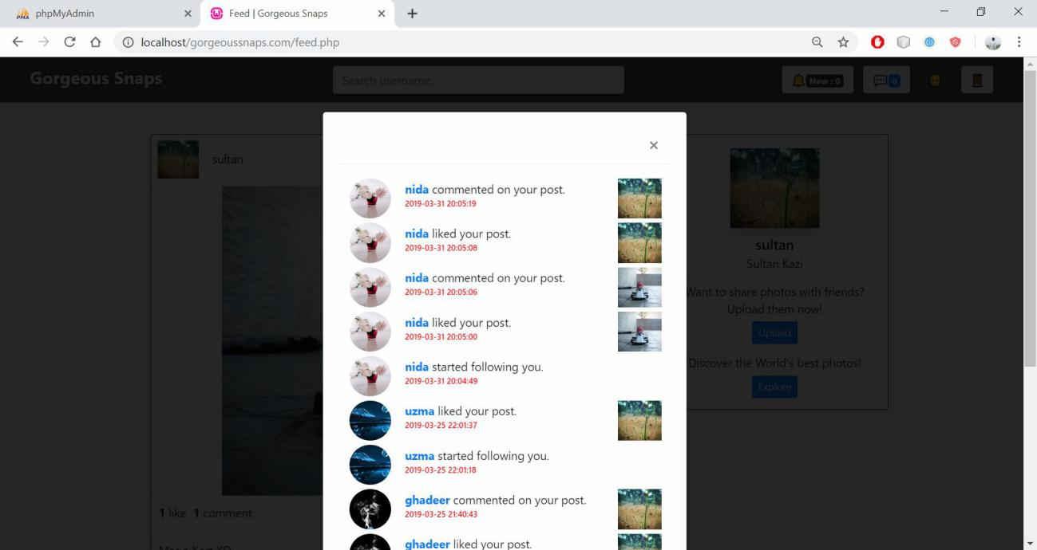
Screenshot
Notification Modal :

Slide 17
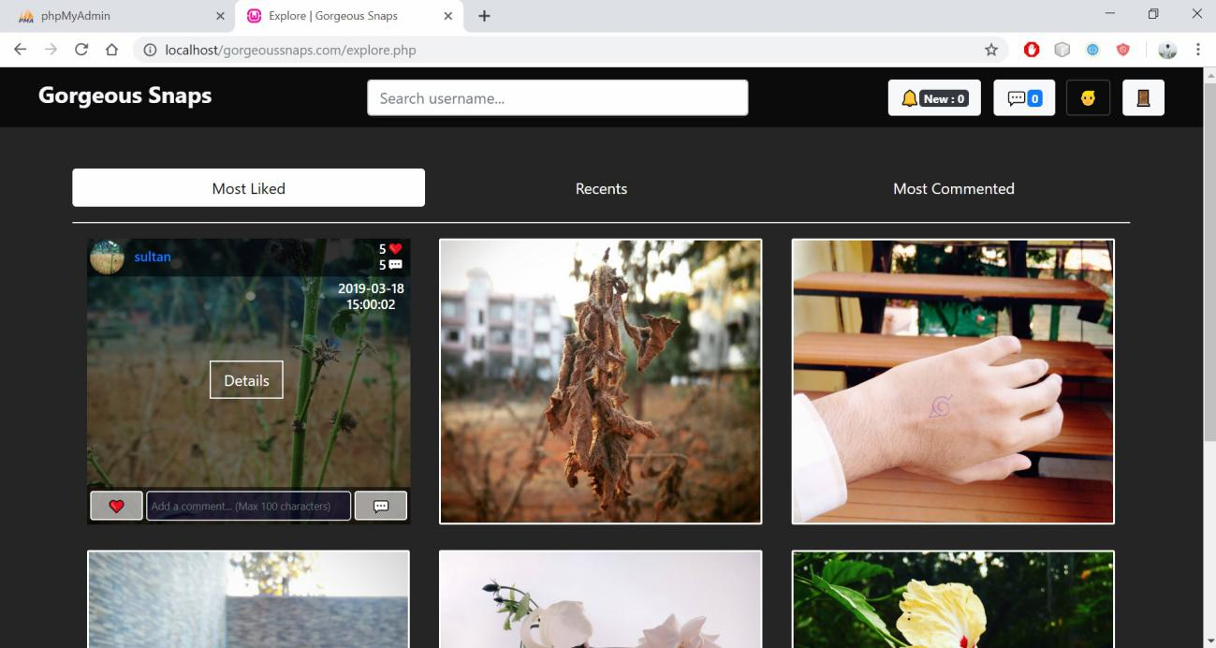
Screenshot
Explore Page (Most Liked Tab) :

Slide 18
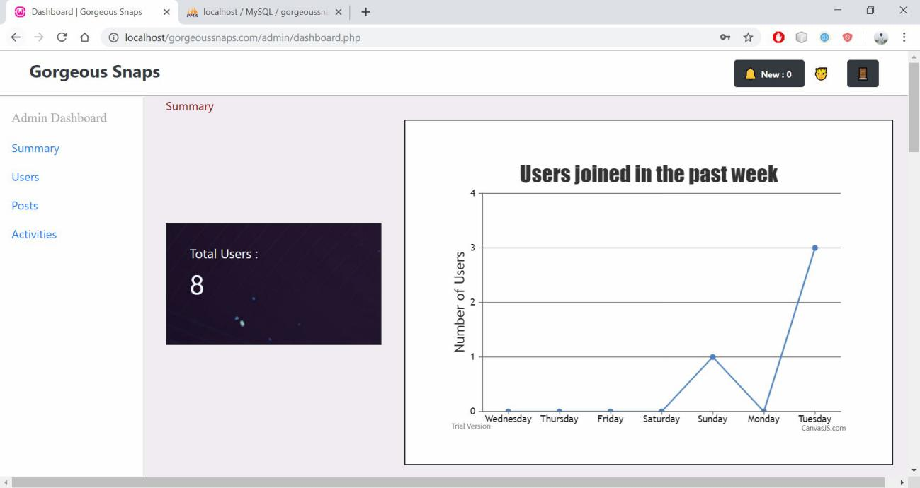
Screenshot
Admin Dashboard (Summary Tab) :

Slide 19
Future Scope
Filters can be added.
Photo editing options such as cropping, brightness and contrast manipulation, etc. can be added.
Implementation of Instagram type stories.
Mentioning of other users in comments or caption can be added.
Account privacy mode (i.e. public accounts and private accounts) can be implemented.

Slide 20
Conclusion
The system has reached a stable state where all of the bugs have been removed.
The system completely works as it was intended to work.
It gives good results as per expectations.
It also displays visualized data on the admin dashboard.

